Slide 1
Apache Kafka - Introduction

Slide 2
What is event streaming?
Practice of capturing data in real-time in the form of streams of events from event sources like
databases,
sensors,
mobile devices,
cloud services,
software applications
Then storing these event streams durably for later retrieval
And manipulating, processing, and reacting to the event streams in real-time as well as retrospectively
And routing the event streams to different destination technologies as needed.
Event streaming thus ensures a continuous flow and interpretation of data so that the right information is at the right place, at the right time.

Slide 3
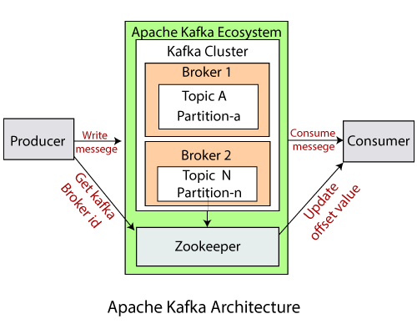
Kafka Architecture

Slide 4
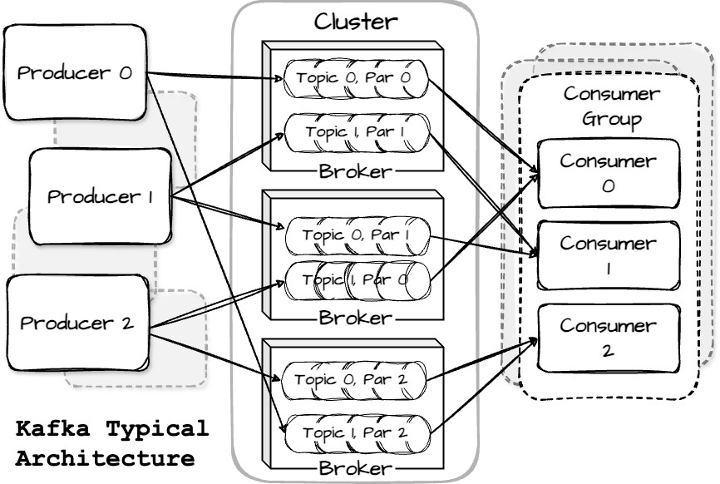
Kafka Architecture

Slide 5
Use Cases for event streaming.
To process payments and financial transactions in real-time, such as in stock exchanges, banks, and insurances.
To track and monitor cars, trucks, fleets, and shipments in real-time, such as in logistics and the automotive industry.
To continuously capture and analyze sensor data from IoT devices or other equipment, such as in factories and wind parks.
To collect and immediately react to customer interactions and orders, such as in retail, the hotel and travel industry, and mobile applications.
To monitor patients in hospital care and predict changes in condition to ensure timely treatment in emergencies.
To connect, store, and make available data produced by different divisions of a company.
To serve as the foundation for data platforms, event-driven architectures, and microservices.

Slide 6
How does kafka work?
An event records the fact that "something happened" in the world or in your business.
When you read or write data to Kafka, you do this in the form of events.
Conceptually, an event has a key, value, timestamp, and optional metadata headers.
Here's an example event:
Event key: "Alice"
Event value: "Made a payment of $200 to Bob"
Event timestamp: "Jun. 25, 2020 at 2:06 p.m."
Producers are those client applications that publish (write) events to Kafka
Consumers are those that subscribe to (read and process) these events.

Slide 7
How does Kafka work? - contd
Topics
Events are organized and durably stored in topics.
Similar to a folder in a filesystem, and the events are the files in that folder. An example topic name could be "payments".
Are always multi-producer and multi-subscriber.
Can have zero, one, or many producers that write events to it.
Can have zero, one, or many consumers that subscribe to these events.
Events in a topic can be read as often as needed—unlike traditional messaging systems, events are not deleted after consumption.
Instead, you define for how long Kafka should retain your events through a per-topic configuration setting, after which old events will be discarded.

Slide 8
How does Kafka work? - contd
Partition
Topics are partitioned, meaning a topic is spread over a number of "buckets" located on different Kafka brokers.
So client applications to both read and write the data from/to many brokers at the same time.
When a new event is published to a topic, it is actually appended to one of the topic's partitions.
Events with the same event key (e.g., a customer or vehicle ID) are written to the same partition
Kafka guarantees that any consumer of a given topic-partition will always read that partition's events in exactly the same order as they were written.

Slide 9
END

